Slide 1
Wireless medium access issues in IOT

Slide 2
The sensor nodes used for deployment, experiment, and evaluation of different WSN related applications have very less processing, storage and communication capabilities.
These unique characteristics along with their limited resources have made WSNs challenging networks.
Integrating sensing, processing, and communication functionalities into a sensor node has added a lot of complexities.
Moving from sensors with only few hours of life time to one with many years of life time demands several iterations of energy efficient techniques.
Shrinking the size of nodes requires small size transceivers.
Mapping the overall system requirements down to individual device capabilities is not an easy task.
Moreover, the direct interaction with the real world requires WSNs to respond accordingly.
As a result, a detailed understanding of capabilities, requirements, constraints, and limitations of WSNs is required.

Slide 3
MAC ( Medium Access control )BASICS FOR WSNs
The MAC sub layer is the part of the data link layer specified in the communication protocol stack shown in Figure below.
It provides channel access mechanisms to several medium-sharing devices.
On a wireless medium, which is broadcast in nature, when one device transmits, every other device in the transmission range receives its transmission.
This could lead to an interference and collision of the frames when a transmission from two or more devices arrives at one point simultaneously.
The nodes of WSNs also share a wireless medium and communicate with each other usually via multi-hop paths in a scattered, dense, and rough sensor field.
A MAC protocol manages the shared-medium and creates a basic network infrastructure for nodes to communicate with each other.
Thus it provides a self-organizing capability to the nodes and tries to enforce the singularity in the network by letting the sender and receiver communicate with each other in a collision-free fashion.

Slide 4
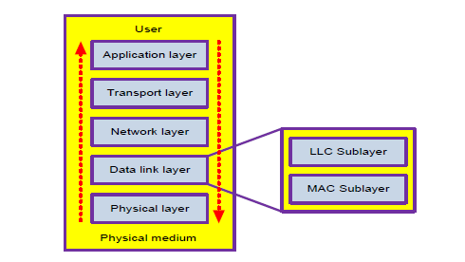

Slide 5
Moreover, the typical requirement to increase lifetime of a WSN without the need of any power replacement and/or human interaction has prompted the development of novel protocols in all layers of the communication stack.
However, prime gains can be achieved at the data link layer, where a MAC protocol directly controls the activities of radio, which is the most power-consuming component of resource-scarce sensor nodes.
In brief, a MAC protocol for WSNs species how nodes employ radio, share the channel, avoid collision in correlated environments, response the inquirer timely, and survive for a long period.

Slide 6
The five-layered simplified model is commonly applied to network research as apposite to the seven-layered OSI model.
An end-user can use application- or task-specific software/algorithms at the application layer.
The transport layer helps maintaining the sensor data flow.
The network layer routes that data on an appropriate path.
The Logical Link Control (LLC) sublayer of the data link layer provides framing,flow control, error control, and link management facilities
Whereas the MAC sublayer shares the wireless medium and helps in energy aware operations for the nodes.
The physical layer takes care of the radio, modulation, transmission, and reception of bits on a physical medium.

Slide 7
MAC Services
The fundamental task of any MAC protocol is to regulate the fair access of nodes to a shared medium in an efficient way in order to achieve good individual throughput and better channel utilization .
However, dense deployment of nodes, collaboration among nodes rather than competition, dispersed applications, often decentralized control, and volatile communication links make WSNs quite a different type of networks.
The responsibilities of a MAC protocol for WSNs therefore differ considerably as of the other wired or wireless networks
On one hand, some relaxations may be granted to a MAC protocol for WSNs.
For example, nodes in WSNs usually send very small frames and use the channel occasionally, either periodically or whenever an important event occurs. As a result, fairness is not as important as in other networks.
In WSNs, nodes remain idle or in sleep mode most of the time and rarely compete for the channel.
Achieving good channel utilization is usually not considered as an important metric. The data flow in WSNs is usually unidirectional, i.e., from nodes to the sink and end-users generally focus on the collective information.

Slide 8
On the other hand, a MAC protocol for WSNs has some extra responsibilities to deal with as well.
First and foremost is the issue of energy conservation. In addition to that and as per application requirements, provision of timeliness, reliability, scalability, and non-synchronized operations may also play an important role in designing a MAC protocol for WSNs.
Additionally, an ideal MAC protocol ensures self-stabilization, graceful adaptation to topology and track changes, an acceptable delivery ratio, low overhead, and low error rates for a WSN.

Slide 9
MAC Challenges
Factors like energy constraints, low transmission ranges, compact hardware, event- or task-based network behavior, self-configuration, and high redundancy make the MAC design for WSNs a complex task and force researchers to develop peculiar MAC protocols which are not common with traditional wireless networks.
A MAC protocol has to mainly address the following sources of energy waste

Slide 10
Idle listening: Since a node in WSNs does not know when it will receive a message, it keeps its radio in ready-to-receive mode, which consumes almost as much energy as in receive mode. In low traffic applications, this is usually a major source of energy waste.
Collisions: A collision is a wasted effort when two frames collide and are discarded. A collision usually results in retransmission and drains more energy in transmitting and receiving extra packets.
Overhearing: An overhearing occurs on the shared-medium when a node receives and processes a gratuitous packet that is not addressed for it. In heavy traffic situations, this could lead to a serious problem.

Slide 11
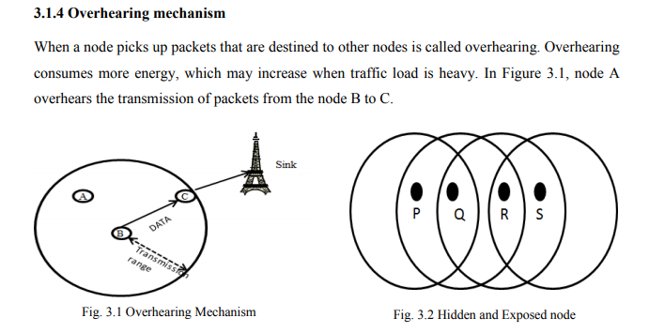

Slide 12
Hidden node problem
In Figure above, nodes P and R are within the range of node Q, but they are not in the range of each other. If node P is communicating to node Q, and node R wishes to communicate to node Q, node R may sense the channel and finds it idle. Otherwise, it causes collision at node Q.

Slide 13
Control packet overhead: An increase in the number and size of control packets results in overhead and energy waste for WSNs, especially when only a few bytes of real data are transmitted in each message. Such control signals also decrease the channel capacity.
Over-emitting: An over-emitting or a deafness occurs due to the transmission of a message when the destination node is not ready to receive it.
Complexity: Computationally expensive algorithms and protocols increase the system complexity which, in result, may cause overhead and consume more energy.

Slide 14
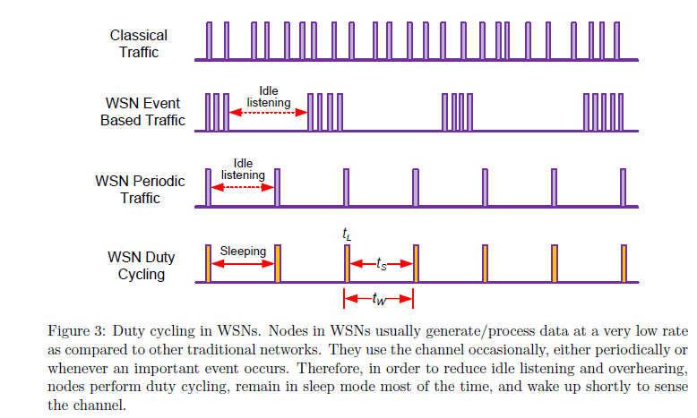

Slide 15
Duty cycling
Though the application domain of WSNs is diverse and broad, environmental monitoring and surveillance have been the most visible applications of WSNs.
The data traffic generated and processed by sensor nodes in such applications can be distinguished in two different classes; periodic traffic and event-based traffic.
The periodic traffic class senses the environment usually at a regular interval and collects the information about temperature, air pressure, humidity, and/or light values of a physical object and report to the sink node .
In event-based traffic class, nodes do not follow a periodic monitoring mechanism, but report the sink node or sound an alarm when something significant occurs in the sensor field. Nodes in this class remain idle most of the time but usually generate a burst of packets during that short time period when an event occurs.

Slide 16
A WSN generally generates much less data traffic and sends very small data frames as compared to traditional wireless or wired networks.
The sensor nodes therefore remain idle most of the time either waiting for their periodic turn to generate data or listening the idle channel for something to occur.
Since the radio consumes as much energy during idle listening as in receiving data packets, switching it in low-power sleep mode and waking up shortly at a periodic interval can significantly conserve the energy of nodes.
All these facts are sketched in figure above where a node periodically switches its radio between sleep and listen periods rather than constantly listening the idle channel.
It turns to sleep mode for a sleep period t_{S} and wakes up and checks the medium for a short listen period t_{L}
The sum of the sleep period and the listen period is called a wake-up period t_{W}, whereas the ratio of the listen period to the wake-up period t_{L}/ t_{W} is called the duty cycle of a node.

Slide 17
Though duty cycling significantly increases system lifetime of a dense WSN by reducing idle listening and over-hearing, it has other implications too.
The transceiver is usually kept in sleep mode most of the time which could end up in significant competition among neighbors at wake-up periods.
This could ultimately lead to collisions, low throughput, and high latency specially in heavy load situations.
The important question which arises here is to select an optimal value of duty cycle for an application.

Slide 18
Choosing a long sleep period induces a significant per-hop latency, since a sending node has to wait an average of half a sleep period before the receiver can accept packets.
Too short sleep phases, i.e., more frequent switching of radio between on and off modes also outweighs the benefits of duty cycling.
Hence, the optimal selection of duty cycle value is a critical step towards achieving the desired system performance.

